Slide 1


Simple algorithms
Bohdan Zashko
.Net, Java Software Developer

Slide 2
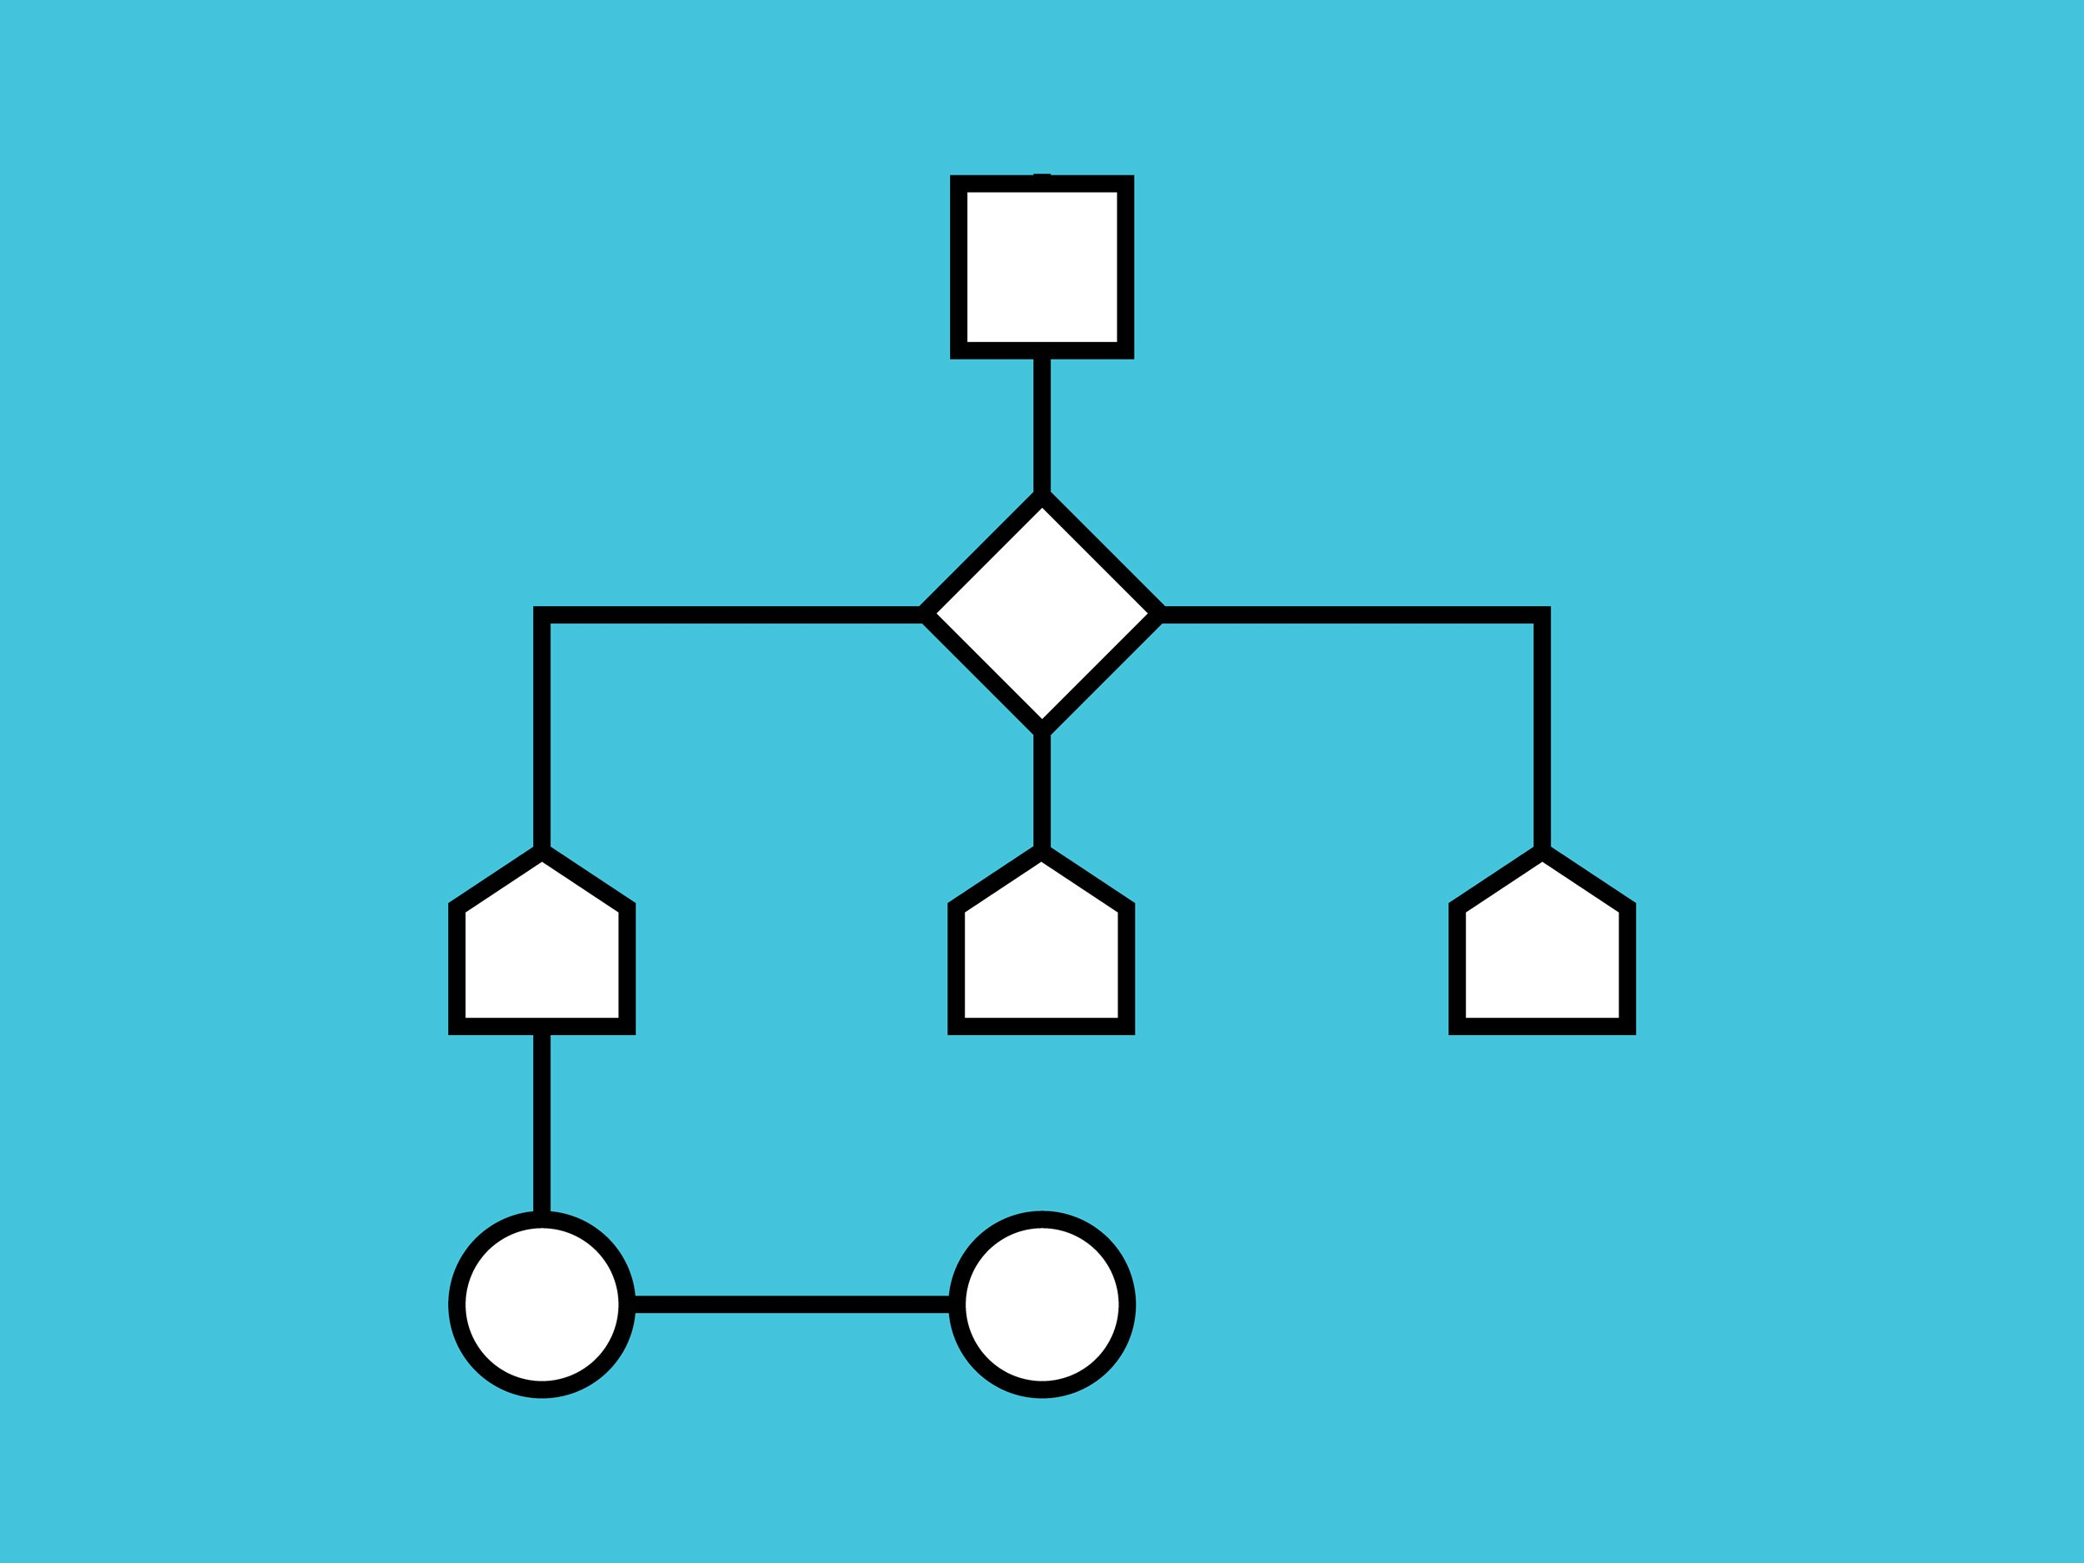
Algorithm
is a set of instructions, typically to solve a class of problems or perform a computation.

Slide 3


Attributes of the algorithms
Determinism
Discreteness
Efficiency
Prevalence
Effectiveness

Slide 4
Representation of the algorithm
Verbal
Graphic
Symbolic

Slide 5

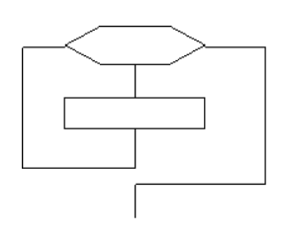
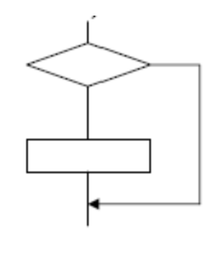
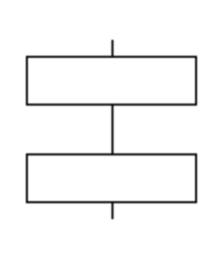
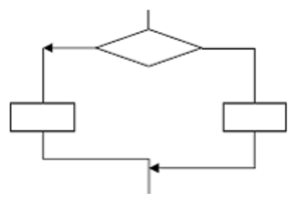
Basic structures of algorithms
Linear
Branched
Cyclic

Slide 6

Сhoice of algorithm
Time..

Slide 7
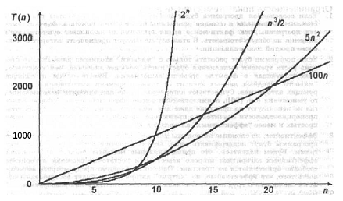
total number of operations
Total number of operations
T(n) = O(f(n)),
where n – input size
10⁴ seconds – 2.8 hours
10⁸ seconds – 3.1 years

Slide 8

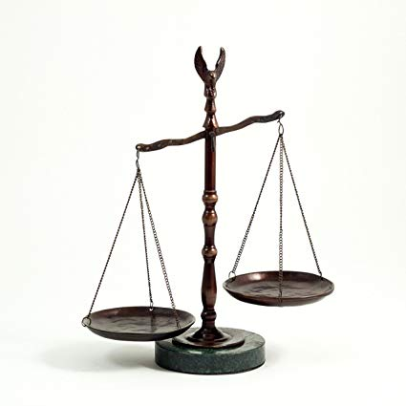
Сhoice of algorithm

Slide 9

Search algorithms
Unordered (==)
Ordered (== and <)

Slide 10
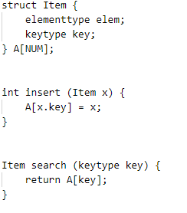
Indexing
O(1)

Slide 11
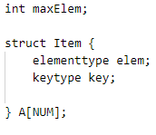
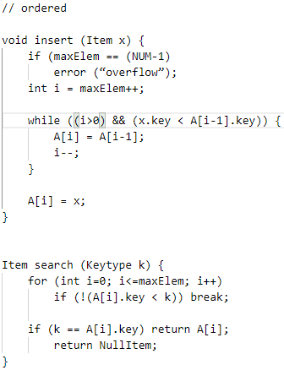
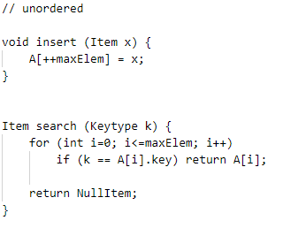
Linear search
O(n)

Slide 12
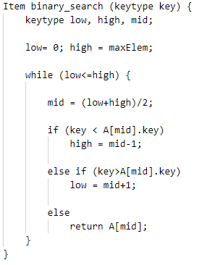
log₂n
Binary search
O(log₂n)
T(n*2) = T(n)+1

Slide 13

Sort algorithms

Slide 14

Bubble

Slide 15
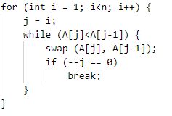
Sort by insert

Slide 16
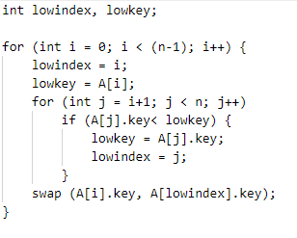
Sort by choise

Slide 17
Bubble, insert, choise - O(n²) !!

Slide 18

Quick search

Slide 19
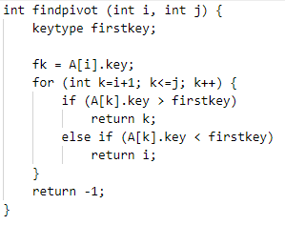
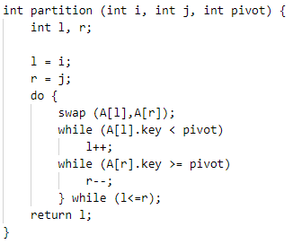
Find pivot
Partition

Slide 20
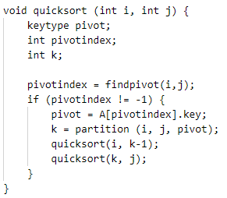
Quick Sort
O(n log n) =)

Slide 21
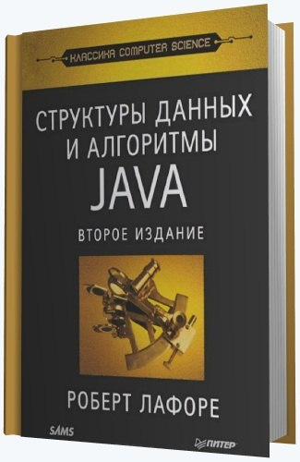
Literature

Slide 22

Q&A

Slide 23
Thank you!

